Slide 1
MINI_PROJECT
Block name : MUL3
Team Members
Sahana S Kori
Sanika Kumbar
Roopa

Slide 2
INTRODUCTION
A mul3 block in a datapath or ALU is a specialized multiplier that specifically multiplies a value by 3.
It’s optimized because multiplying by a constant (3) can be implemented with fewer gates than a general-purpose multiplier (using only adder and shift logic).

Slide 3
Sub-blocks in this MUL3
INVERTER
HALF_ADDER
FULL_ADDER
MUL2

Slide 4
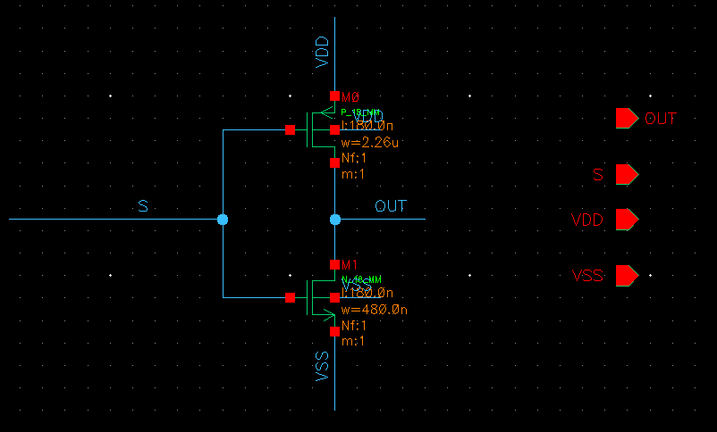
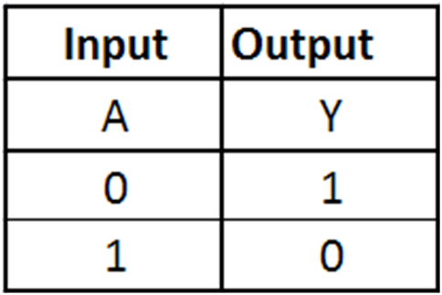
INVERTER SCHEMATIC

Slide 5
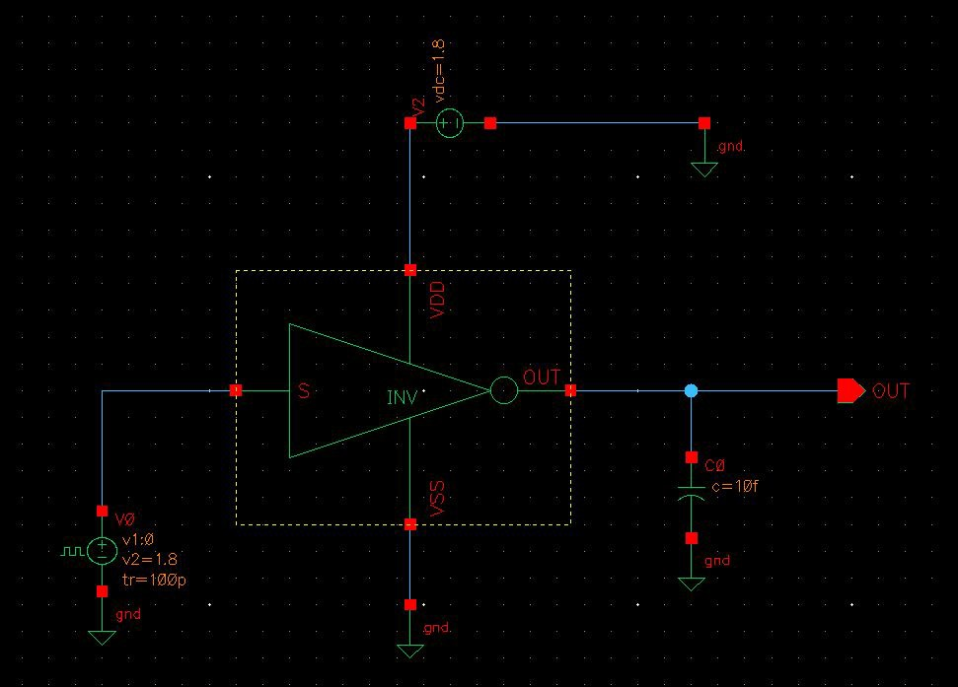
INVERTER TESTBENCH

Slide 6
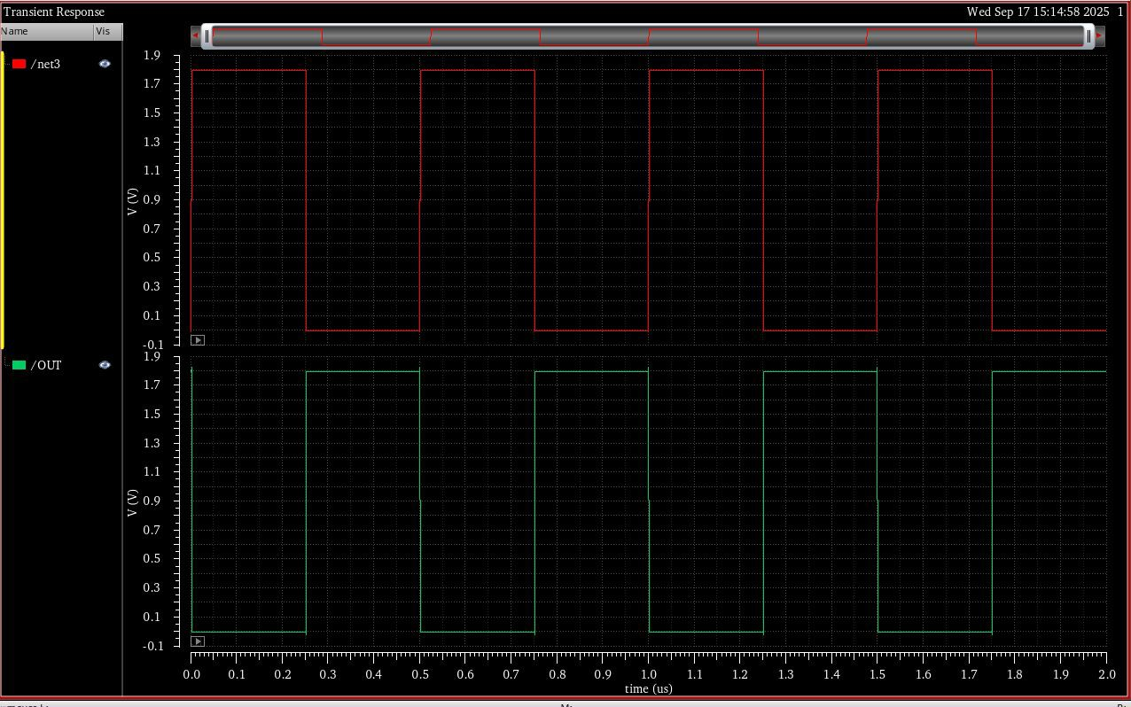
INVERTER SIMULATIONS

Slide 7
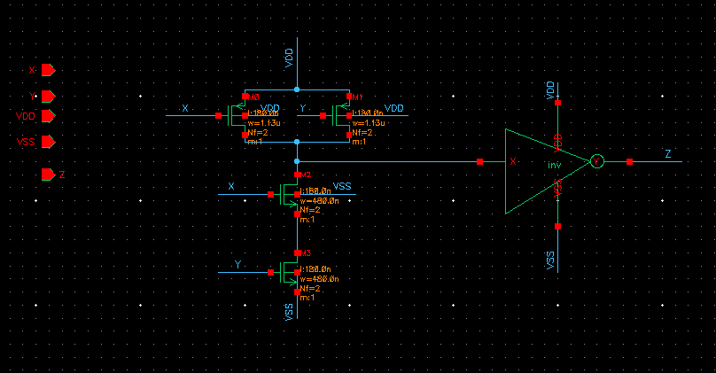
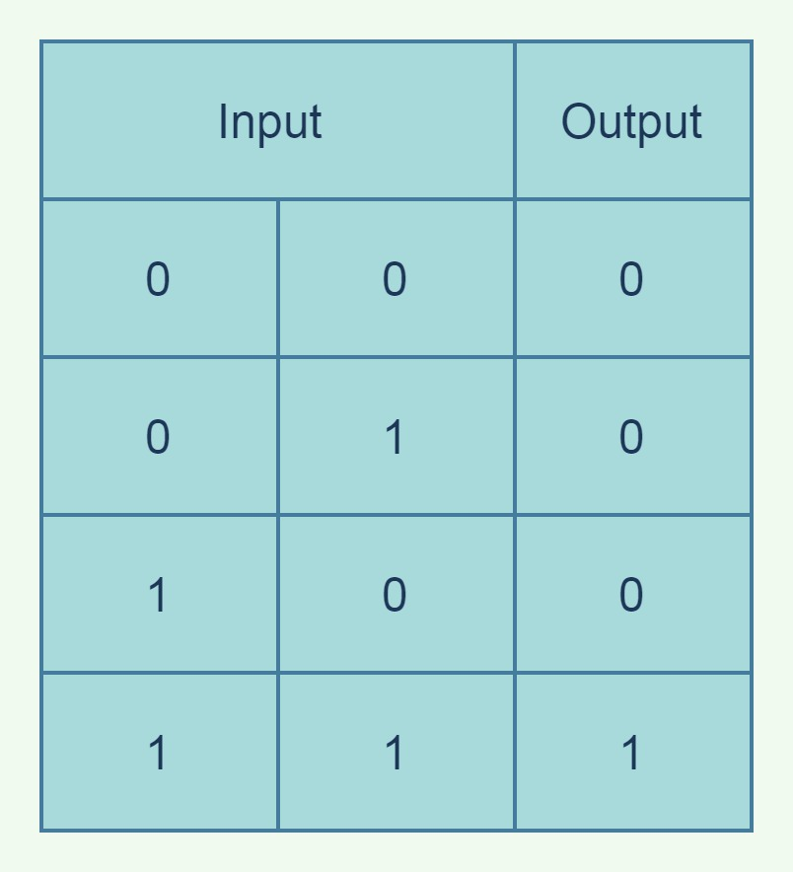
AND SCHEMATIC

Slide 8
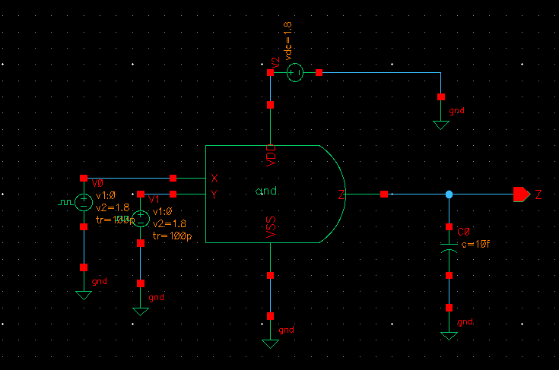
AND TESTBENCH

Slide 9
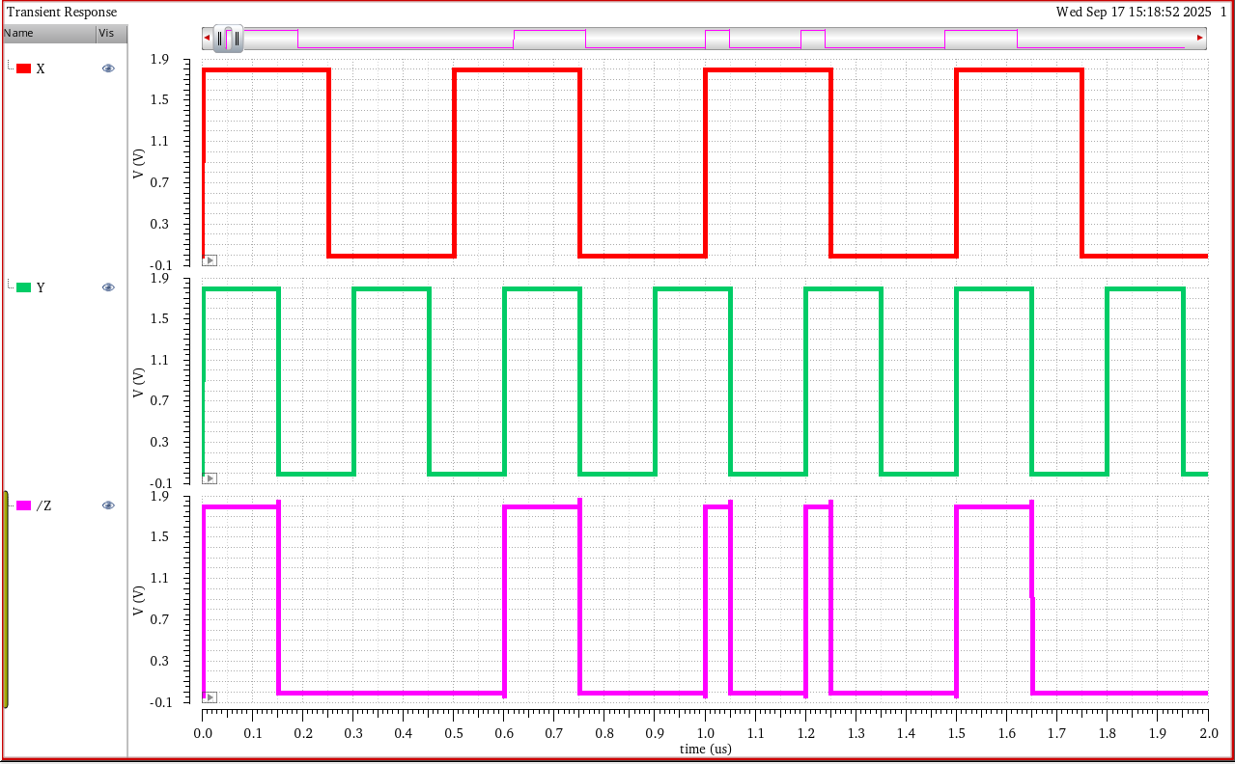
AND SIMULATIONS

Slide 10
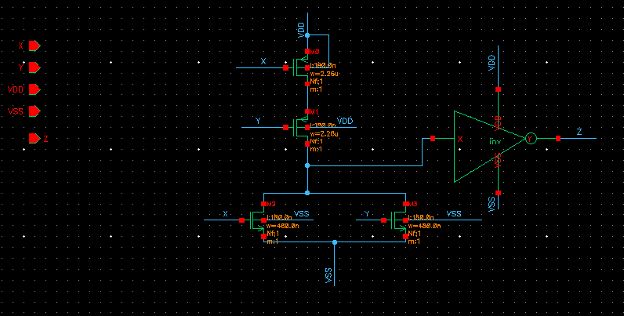
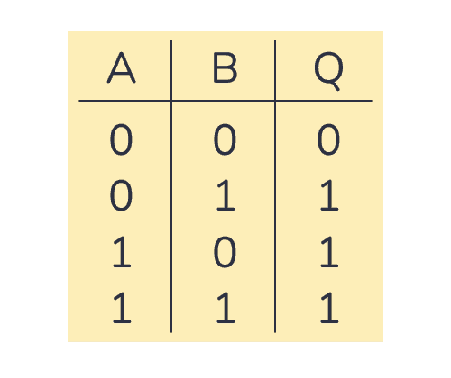
OR SCHEMATIC

Slide 11
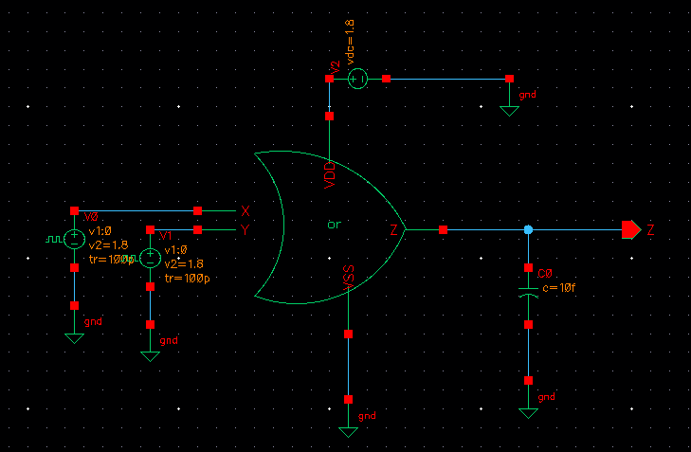
OR TESTBENCH

Slide 12
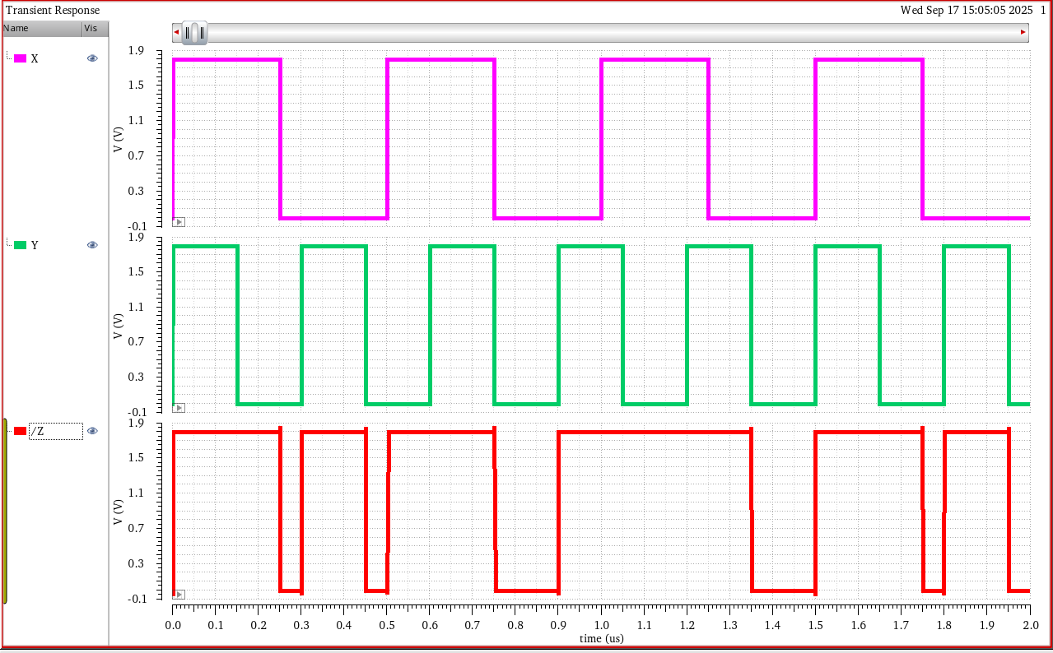
OR SIMULATIONS

Slide 13
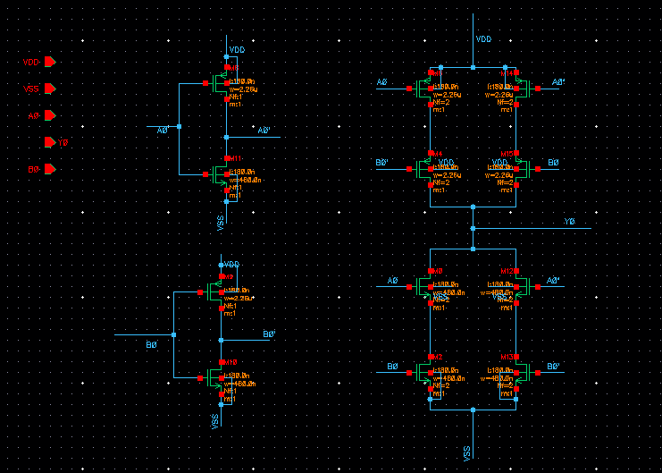
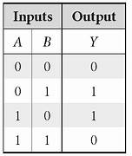
XOR_2 SCHEMATIC

Slide 14
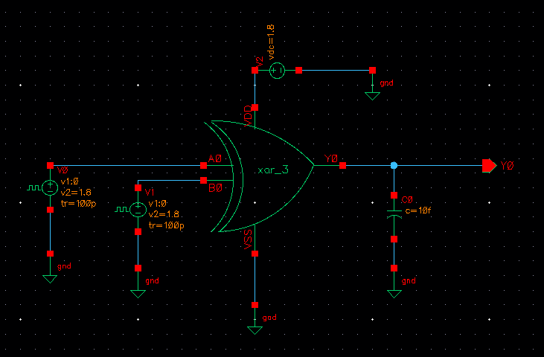
XOR_2 TESTBENCH

Slide 15
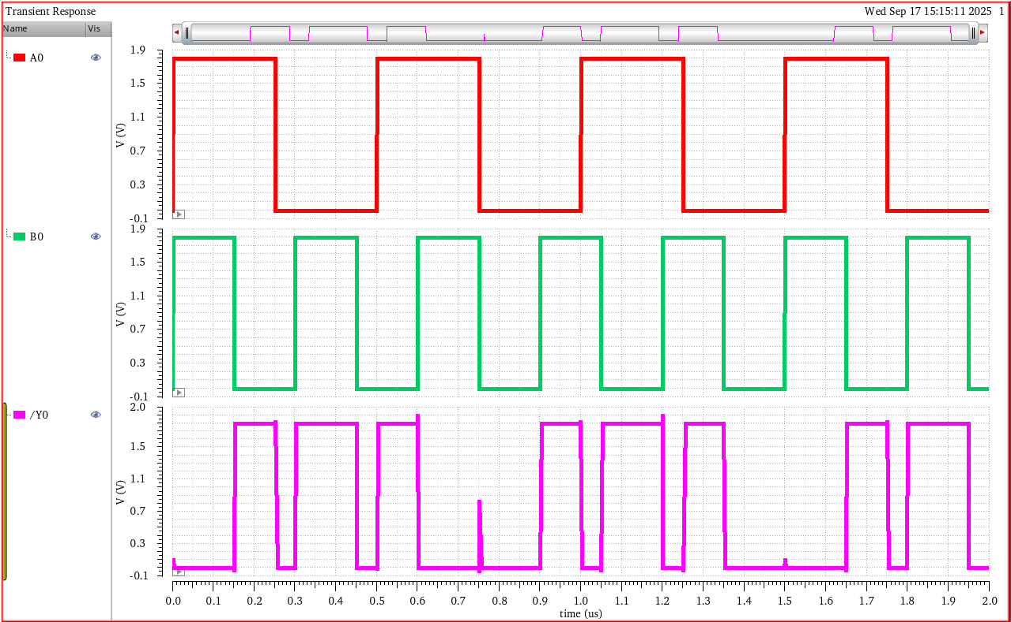
XOR_2 SIMULATIONS

Slide 16
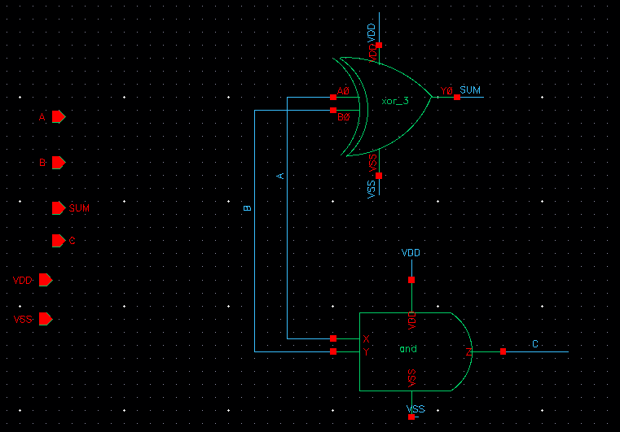
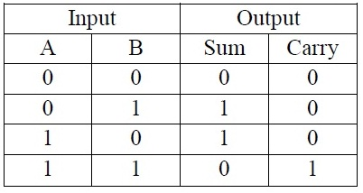
HALF_ADDER SCHEMATIC

Slide 17
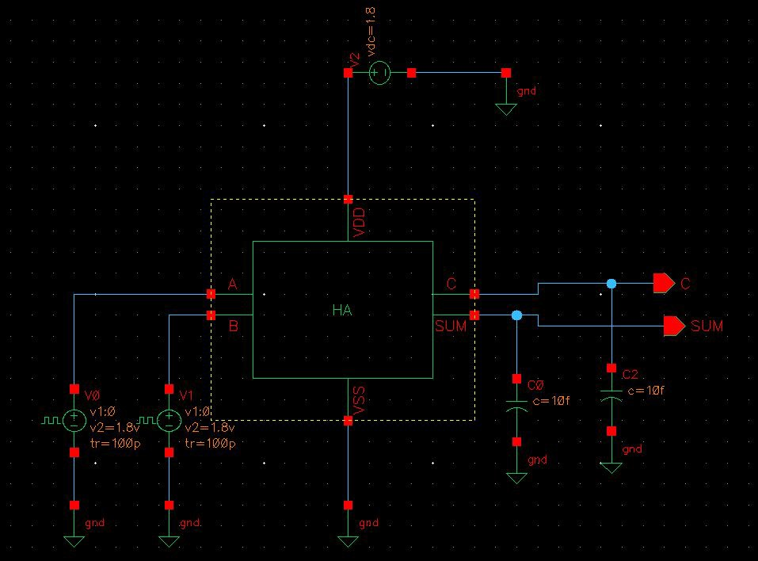
HALF_ADDER TESTBENCH

Slide 18
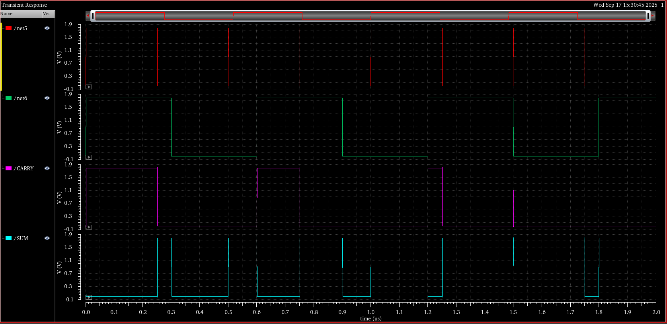
HALF_ADDER SIMULATIONS

Slide 19
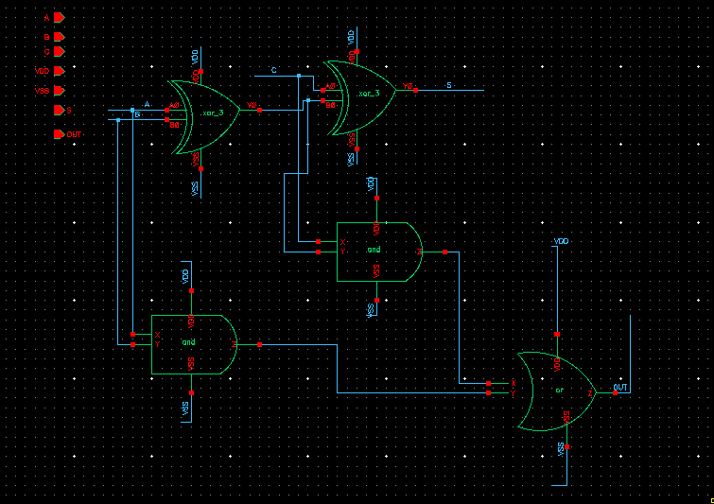
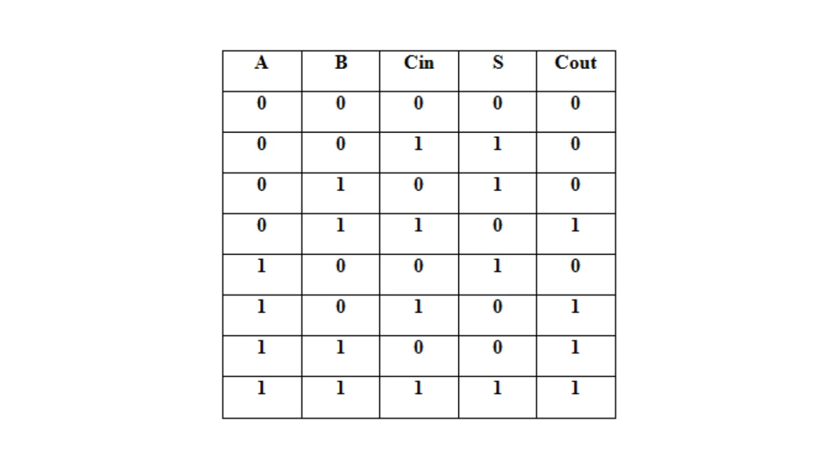
FULL_ADDER SCHEMATIC

Slide 20
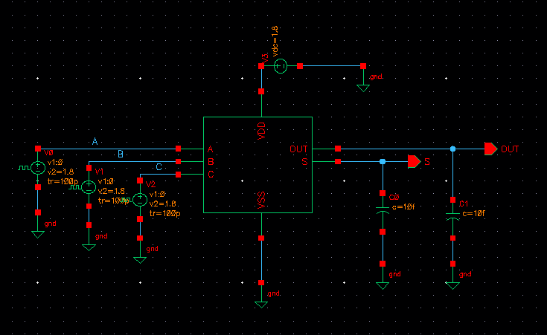
FULL_ADDER TESTBENCH

Slide 21
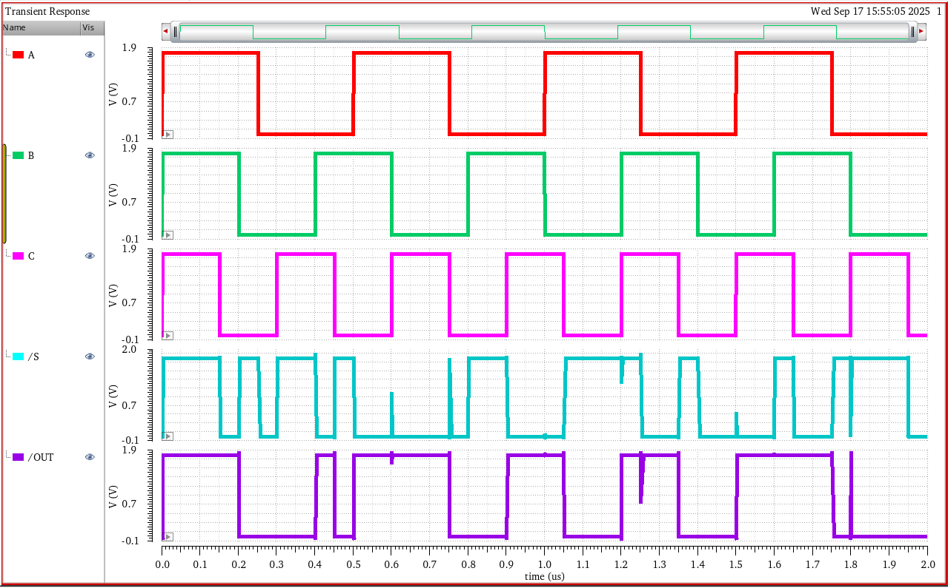
FULL_ADDER SIMULATIONS

Slide 22
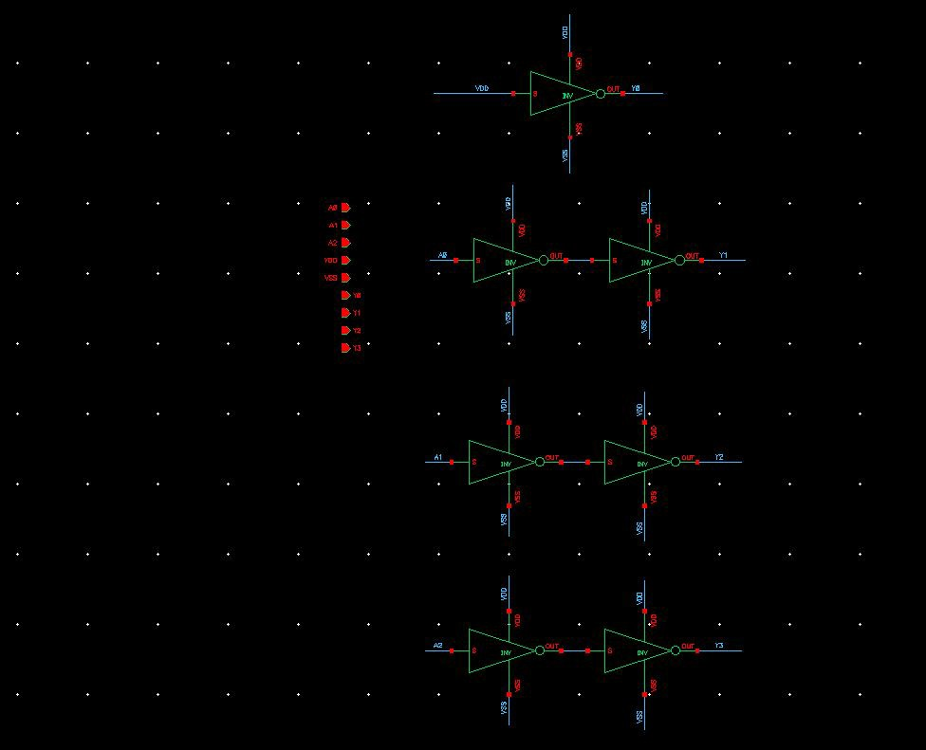
MUL2 SCHEMATIC

Slide 23
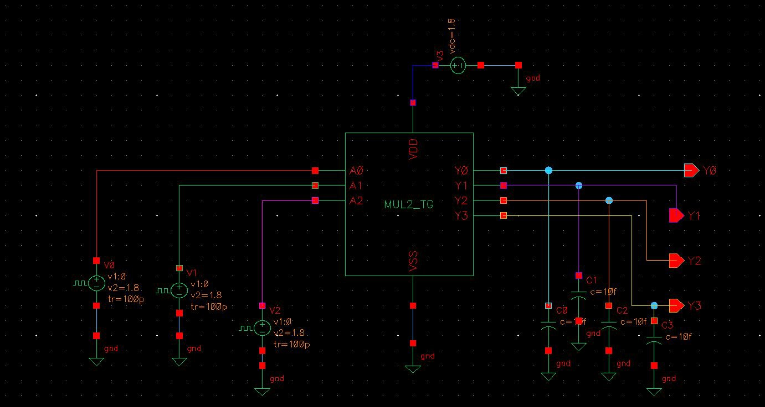
MUL2 TESTBENCH

Slide 24
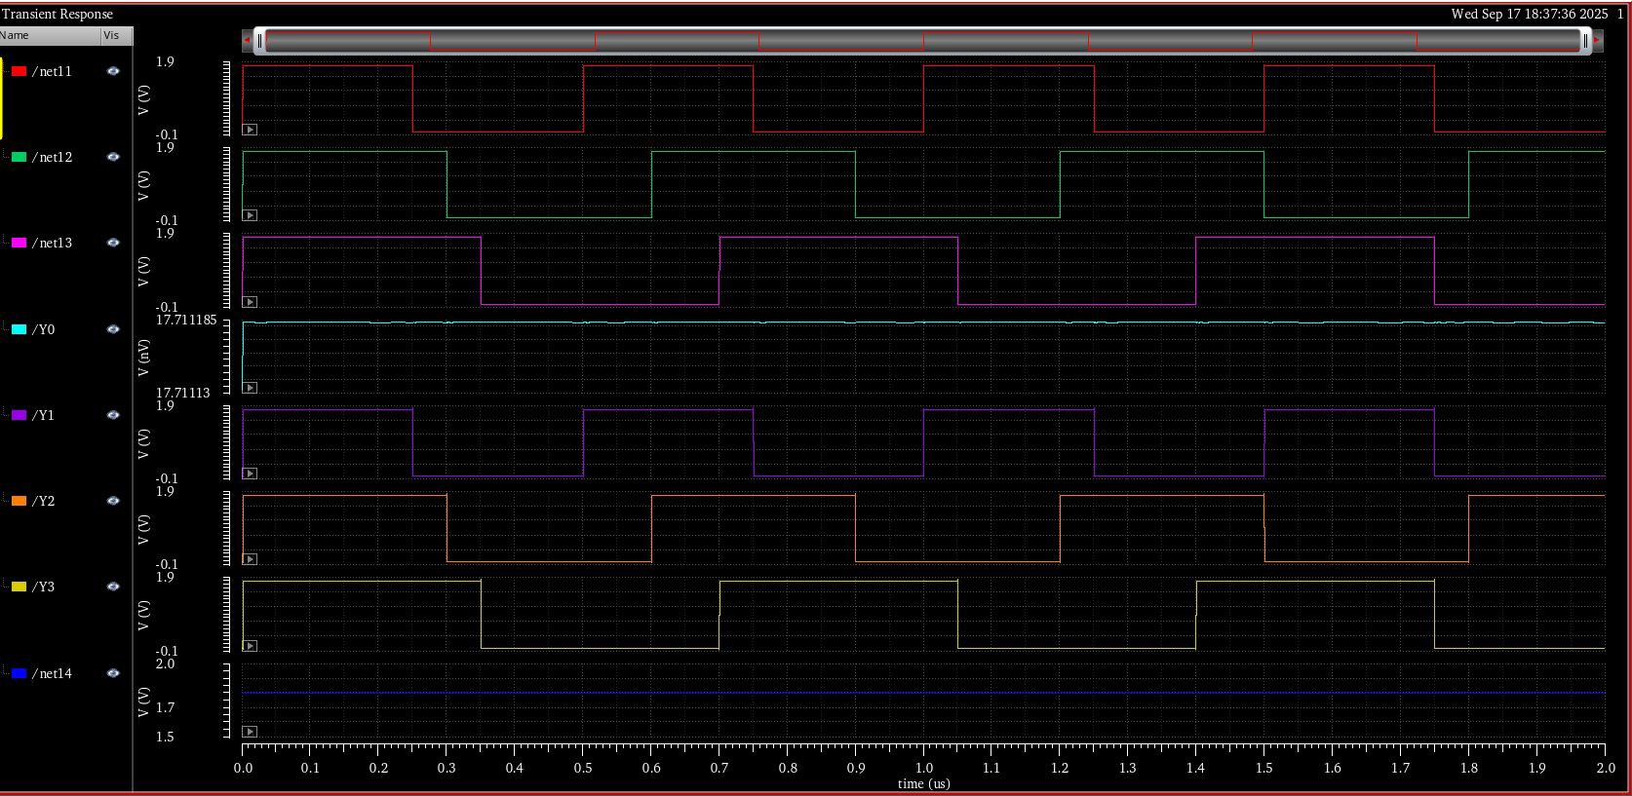
MUL2 SIMULATIONS

Slide 25
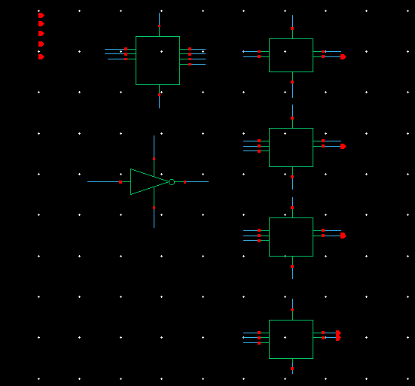
MUL3 SCHEMATIC

Slide 26
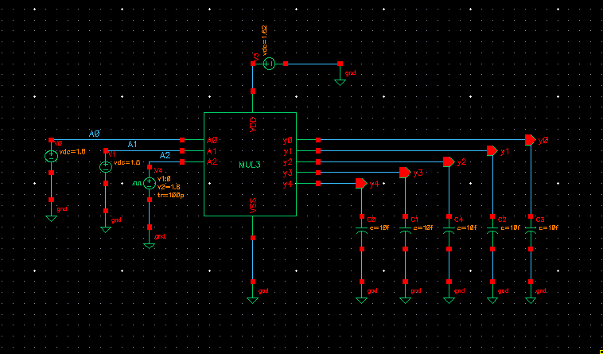
MUL3 TESTBENCH

Slide 27
TRUTH TABLE _ MUL3
VDD | A2 | A1 | A0 | Y4 | Y3 | Y2 | Y1 | Y0
1 | 0 | 0 | 0 | 0 | 0 | 0 | 0 | 0
1 | 0 | 0 | 1 | 0 | 0 | 0 | 1 | 1
1 | 0 | 1 | 0 | 0 | 0 | 1 | 1 | 0
1 | 0 | 1 | 1 | 0 | 1 | 0 | 0 | 1
1 | 1 | 0 | 0 | 1 | 1 | 1 | 0 | 0
1 | 1 | 0 | 1 | 0 | 1 | 1 | 1 | 1
1 | 1 | 1 | 0 | 1 | 0 | 0 | 1 | 0
1 | 1 | 1 | 1 | 1 | 0 | 1 | 0 | 1

Slide 28
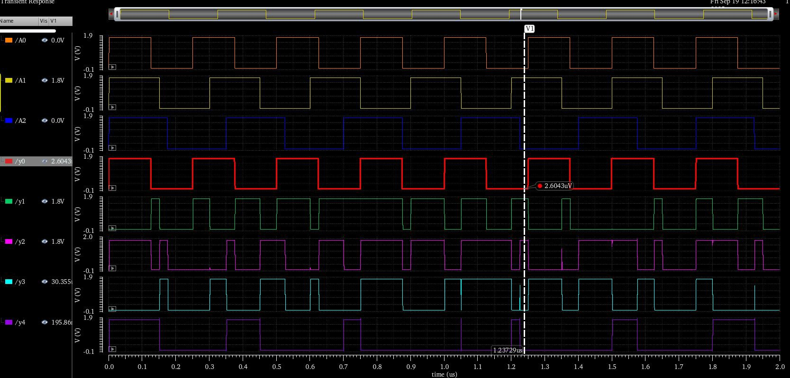
MUL3 SIMULATIONS

Slide 29
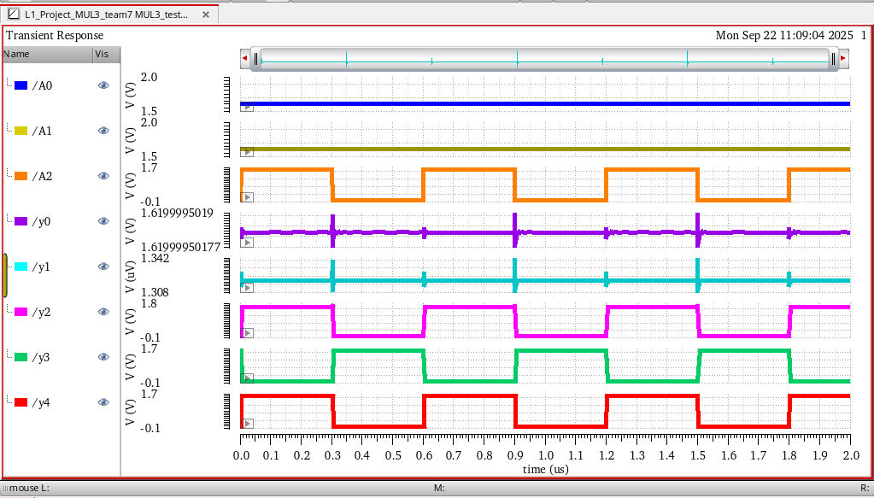
ss – slow-slow , 1.62 , 100 degree

Slide 30
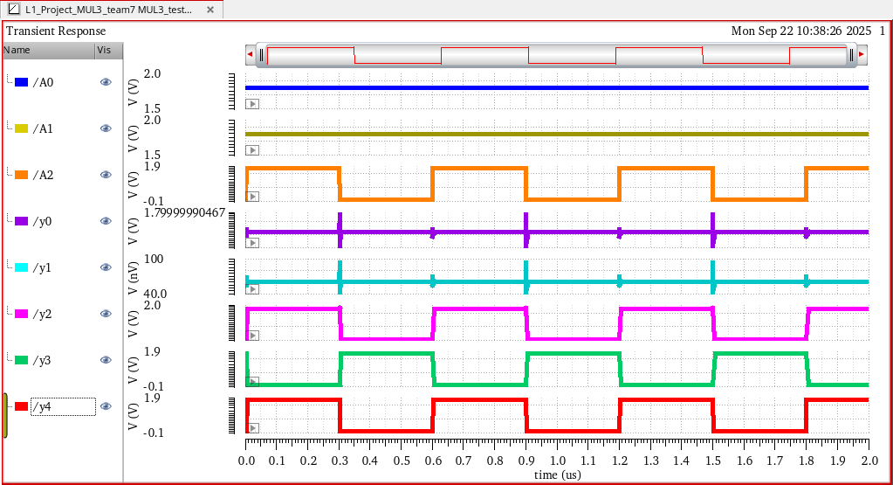
tt – typical-typical , 1.8 , 27 degree

Slide 31
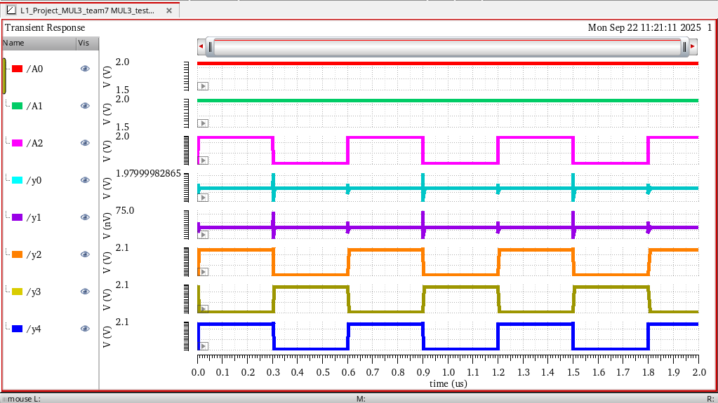
ff – fast-fast , 1.98 , 0 degree

Slide 32
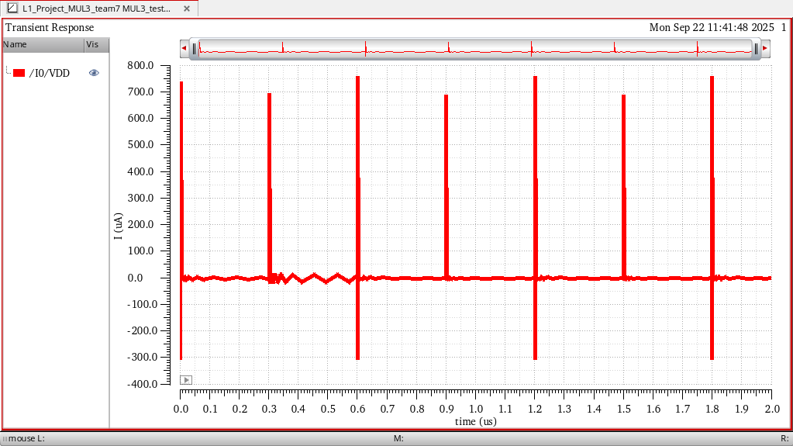
Current Waveform

Slide 33
WORST DELAY A2 🡪 Y3
PROCESS | ss | tt | ff
RISE DELAY | 540.02ps | 345.902ps | 257.22ps
FALL DELAY | 633.54ps | 338.173ps | 286.748ps
CURRENT | 1.010uA | 1.1uA | 1.257uA
Number of Transistors used = 160
More delay is in ss
More current is in ff

Slide 34
APPLICATIONS
Arithmetic and logic units (ALUs)
Digital Signal Processing
Graphics and Image Processing
Computer Graphics / Geometry

Slide 35
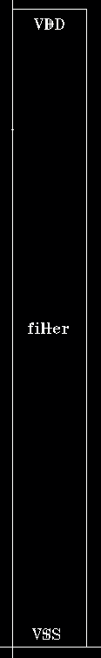
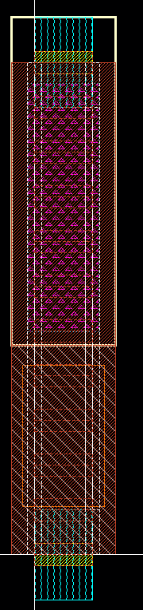
Filler Floor Plan and Layout:

Slide 36
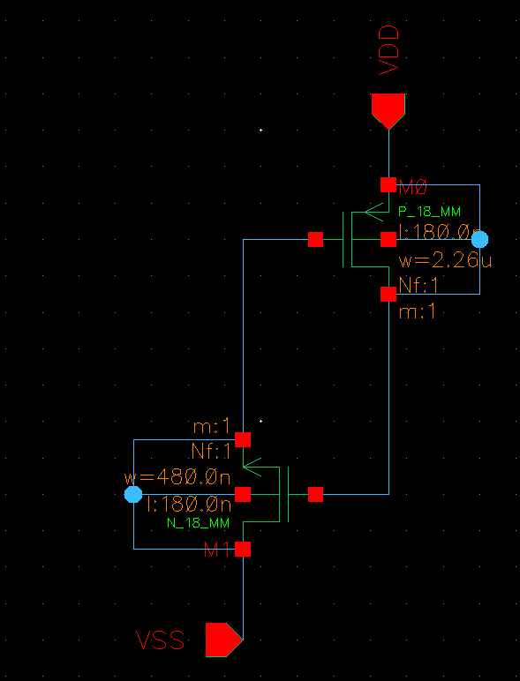
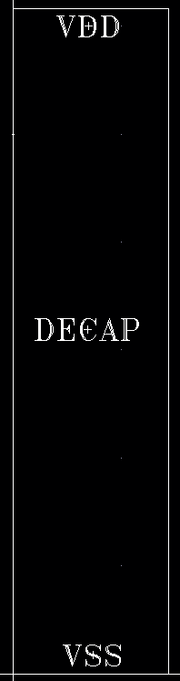
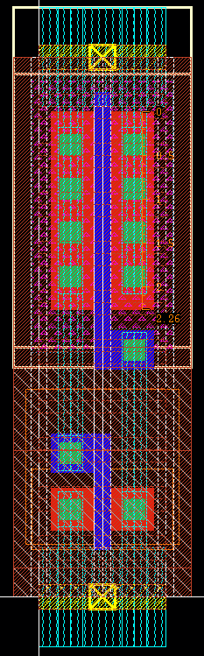
Decap Schematic, Floor Plan, Layout:

Slide 37
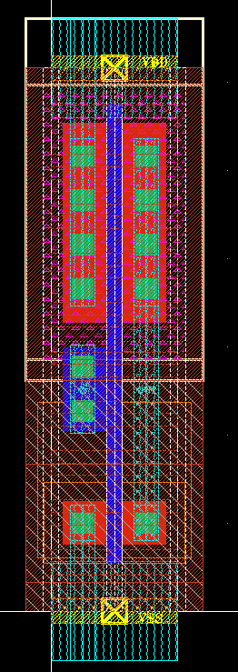
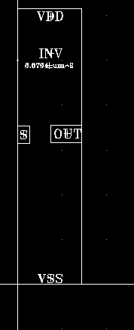
Inverter Floor Plan and Layout:

Slide 38
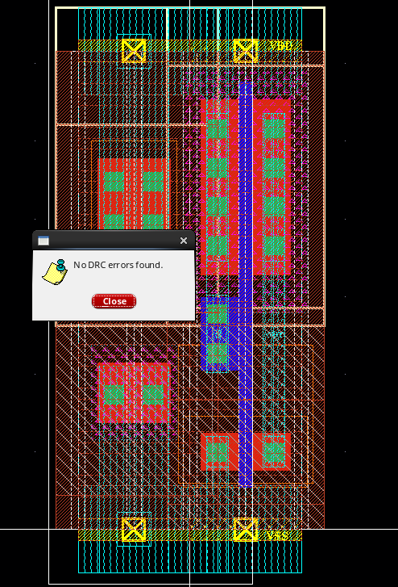
DRC Check:

Slide 39
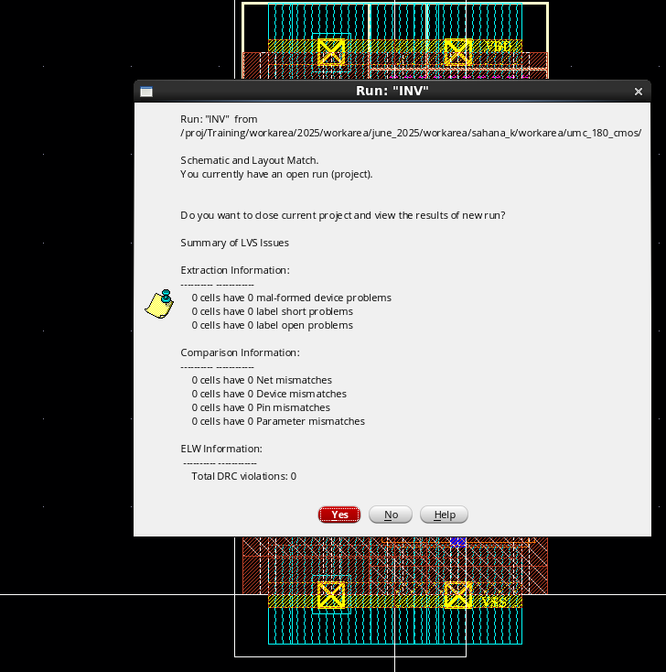
LVS Check:

Slide 40
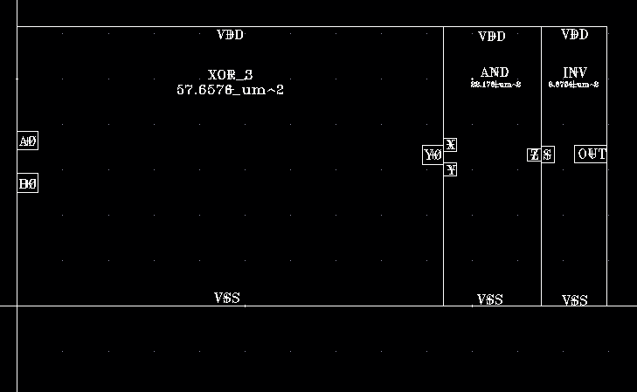
Half Adder Floor Plan:

Slide 41
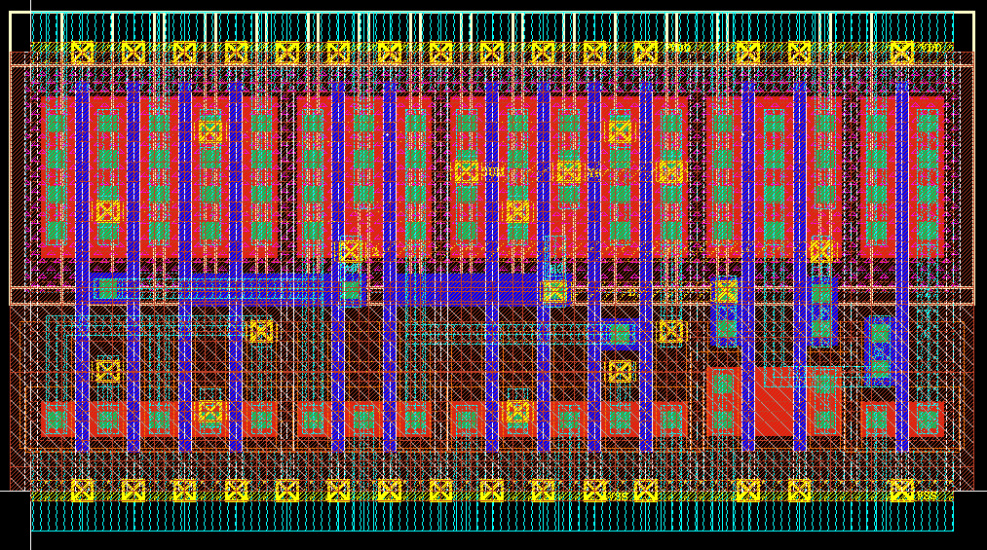
Half Adder Layout:

Slide 42
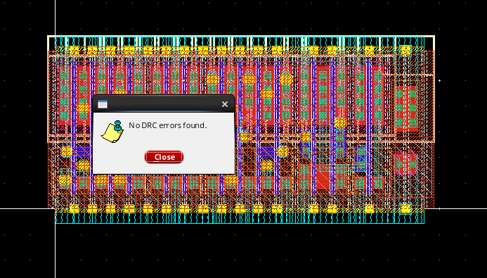
DRC Check:

Slide 43
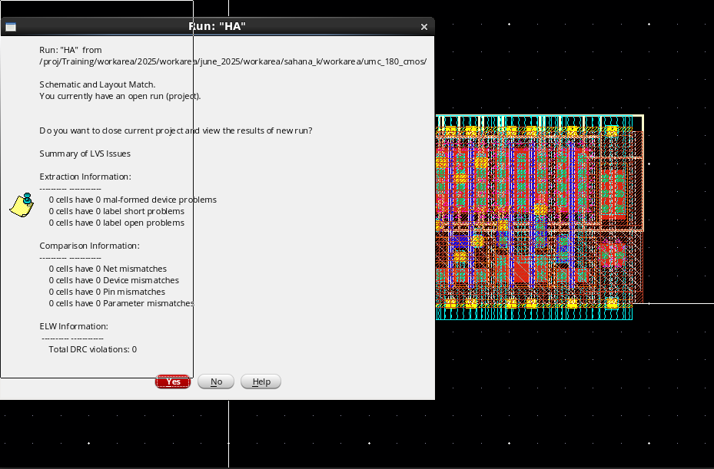
LVS Check:

Slide 44
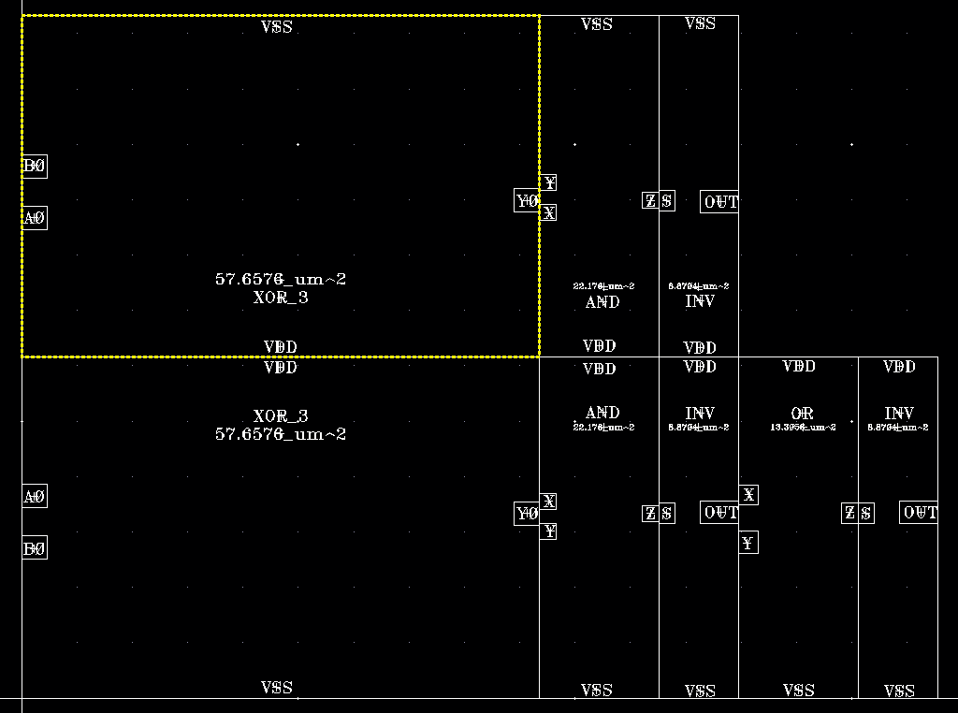
Floor Plan of Full Adder:

Slide 45
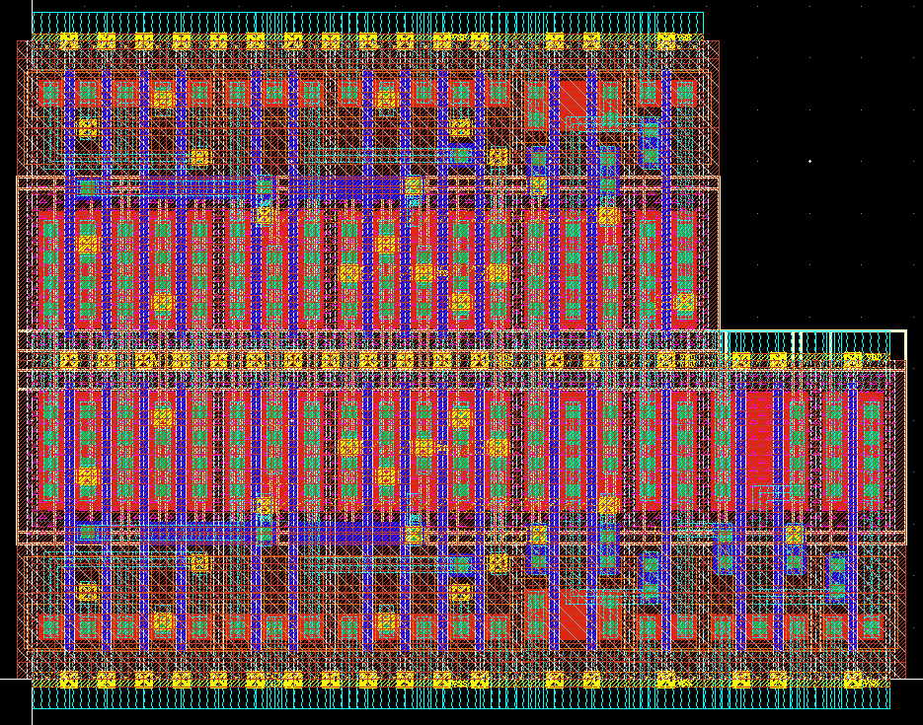
Layout of Full Adder:

Slide 46
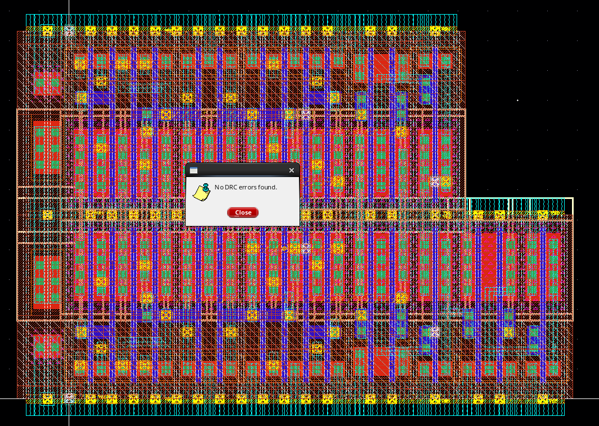
DRC Check:

Slide 47

LVS Check:

Slide 48

Floor Plan of MUL2:

Slide 49

Layout of MUL2:

Slide 50

DRC Check:

Slide 51

LVS Check:

Slide 52

Floor Plan of MUL3:

Slide 53

Layout of MUL3:

Slide 54

DRC Check:

Slide 55

LVS Check:

Slide 56


Slide 57

Power Mesh:

Slide 58
Learning outcomes from Sahana:
As the team lead, I developed valuable management and coordination skills.
I learned the importance of optimizing floorplans through multiple iterations to ease placement and routing.
Encountering various errors improved our problem-solving abilities and understanding of design issues.
I also gained knowledge about decaps, fillers, and the benefit of frequent DRC checks to minimize final errors.
Overall, leading the team was a valuable experience. It enhanced my teamwork and coordination skills while making the learning process enjoyable.
Together, we identified and resolved different types of errors through effective communication and collaboration.

Slide 59
Learning outcomes from Sanika:
We divided the main block into sub-blocks — Half Adder, Full Adder, and Mul2. I focused on Mul2 to understand its functionality, role in Mul3, and how it reduces circuit complexity. Then I studied the main block (Mul3), prepared its truth table, and learned why Y4 remains zero while the last two outputs are 1.
After schematic and simulation, I performed delay, PVT, and current analysis, identifying the longest delay paths. During floorplanning, I learned about schematic–layout connectivity (XL) and “Generate from Source.” I completed the Mul2 layout, created a stick diagram for XOR3, and with Roopa, handled routing challenges to minimize Metal2 usage.
I designed Decap and filler cells and understood their importance in layout design. For the main MUL3 layout, our team worked together, cleared DRC errors, and solved LVS issues caused by missing tap cells.
This project gave me strong practical knowledge of circuit design, layout creation, and verification

Slide 60
Learning outcomes from Roopa:
I learned what is floorplanning how to do floorplanning, How it eases further steps in layout.
I learned placement of devices, How to do it and why is it important.
Learned what is power planning and how to do it and how it affects it for layout.
Our project is MUL3, I learned what is MUL3, how it works and it’s functionality, where it is used.

Slide 61
Challenges Faced:
Initially, we worked on the functionality and design of the decap cell, followed by editing the layout template as per the project requirements. Later, we realized that tapcells were not placed in the bottom row, which caused VSS connectivity errors during LVS. To resolve this issue, we had to add tapcells properly, which led to an increase in the overall block area and required us to modify the floorplan accordingly. These adjustments and corrections were among the key challenges our team faced during the project.

Slide 62
THANK YOU

